Slide 1
Operators

Slide 2

Boolean
A boolean data type represents one of the two values: True or False. The use of these data types will be clear once we start using the comparison operator. The first letter T for True and F for False should be capital unlike JavaScript. Example: Boolean Values

Slide 3
Operators
Python language supports several types of operators. In this section, we will focus on few of them.

Slide 4
Assignment Operators
Assignment operators are used to assign values to variables. Let us take = as an example. Equal sign in mathematics shows that two values are equal, however in Python it means we are storing a value in a certain variable and we call it assignment or a assigning value to a variable.

Slide 5
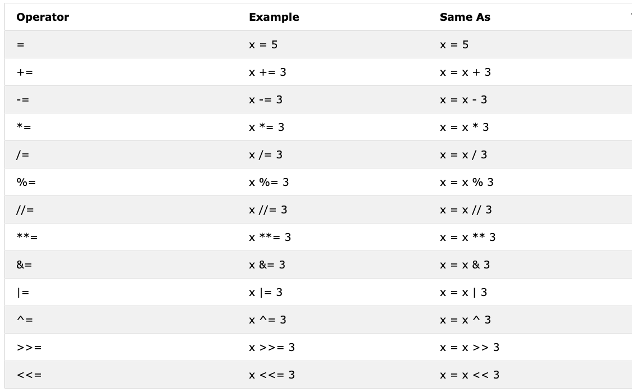

Slide 6
Arithmetic Operators:
Addition(+): a + b
Subtraction(-): a - b
Multiplication(*): a * b
Division(/): a / b
Modulus(%): a % b
Floor division(//): a // b
Exponentiation(**): a ** b

Slide 7
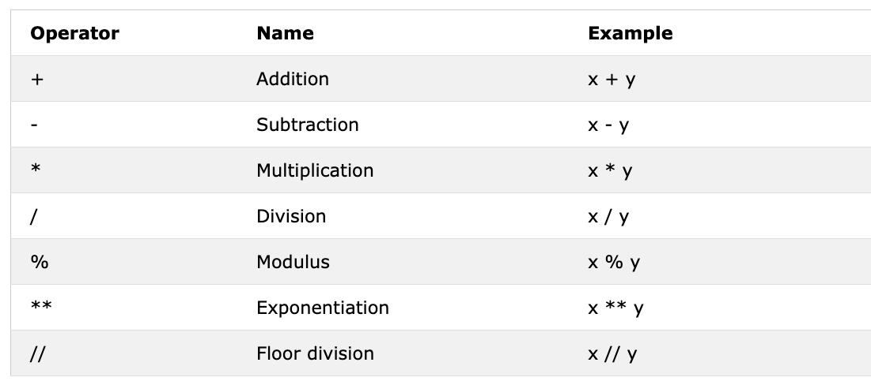

Slide 8
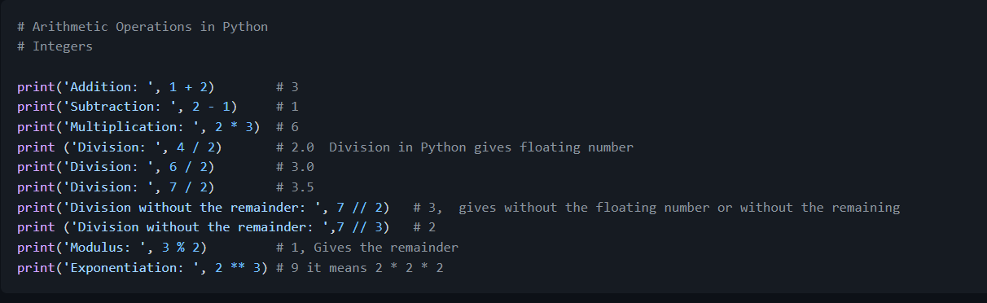
Example:Integers

Slide 9
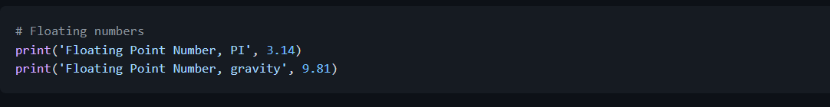
Example:Floats

Slide 10
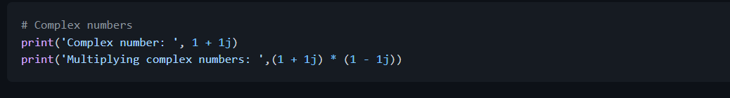
Example:Complex numbers

Slide 11
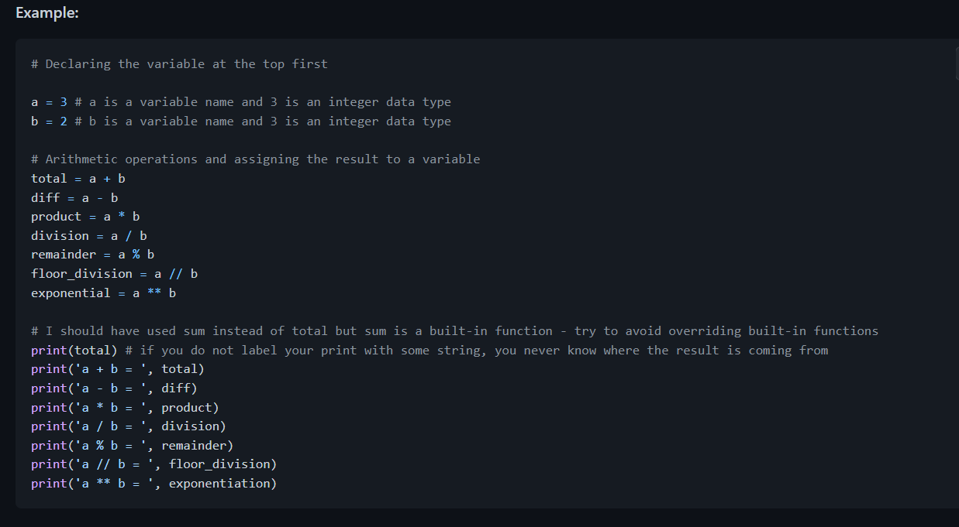
Let's declare a variable and assign a number data type. I am going to use single character variable but remember do not develop a habit of declaring such types of variables. Variable names should be all the time mnemonic.

Slide 12
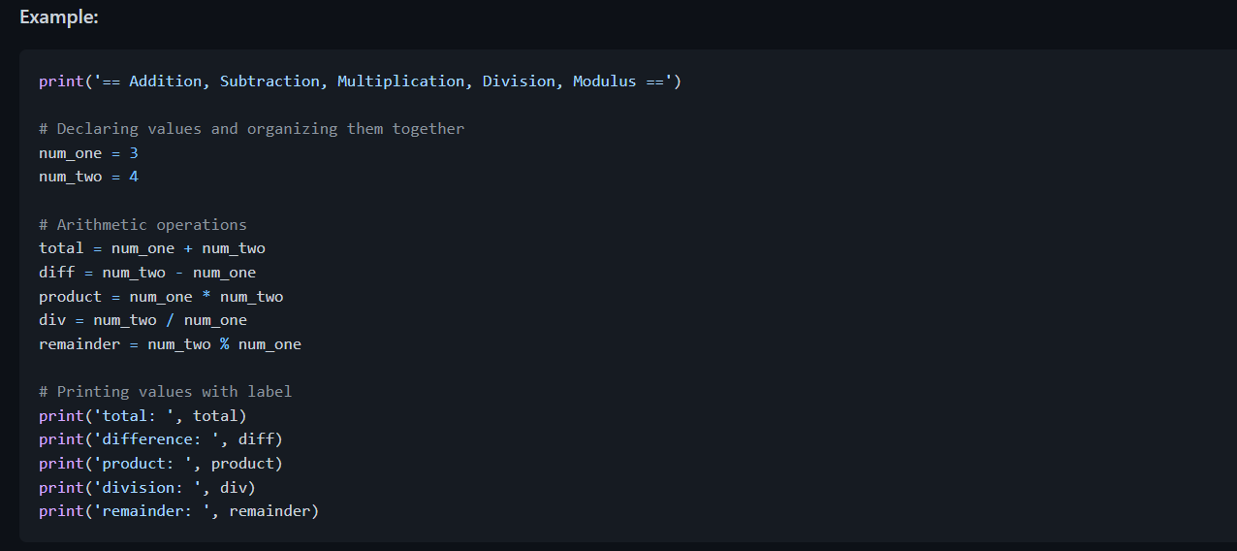
`

Slide 13
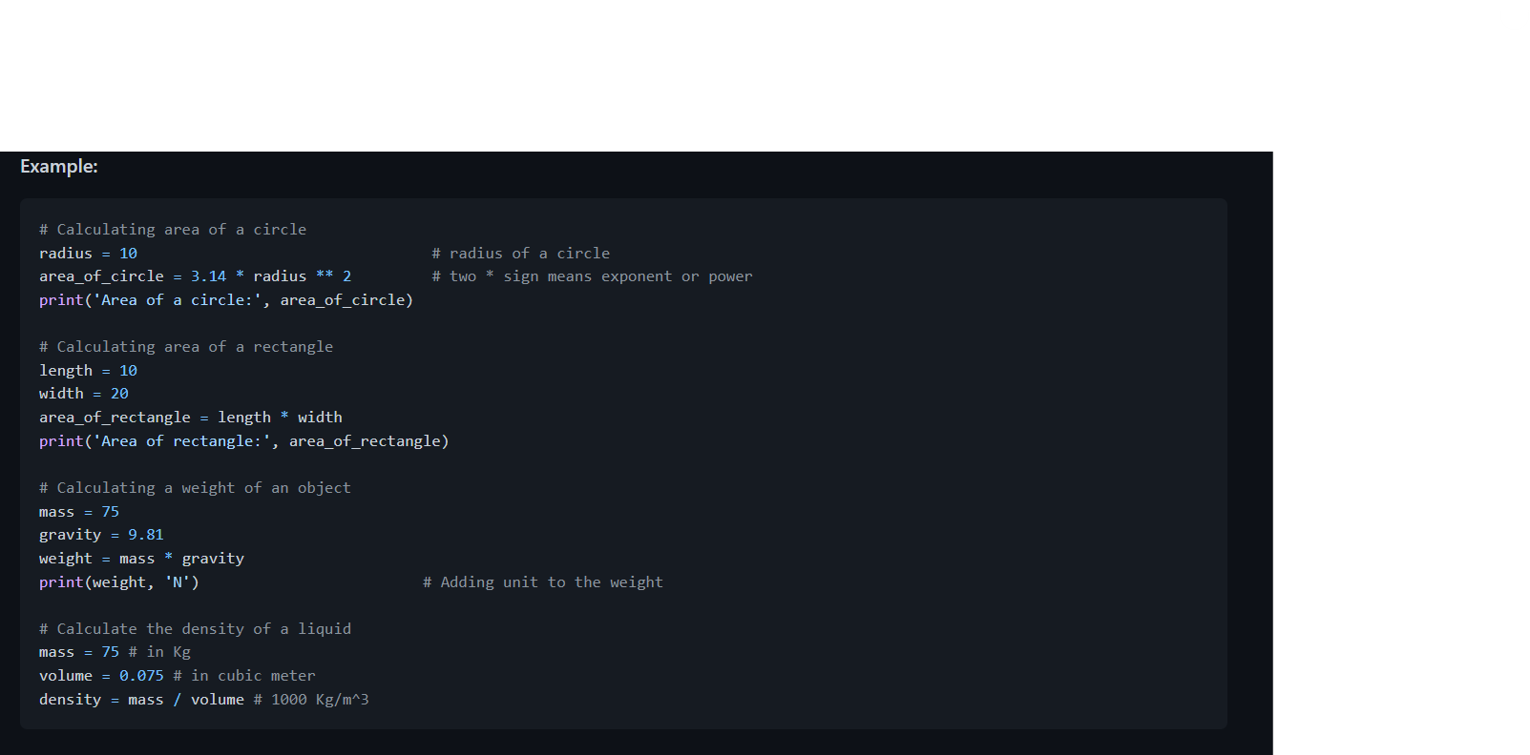
Let us start start connecting the dots and start making use of what we already know to calculate (area, volume,density, weight, perimeter, distance, force).

Slide 14
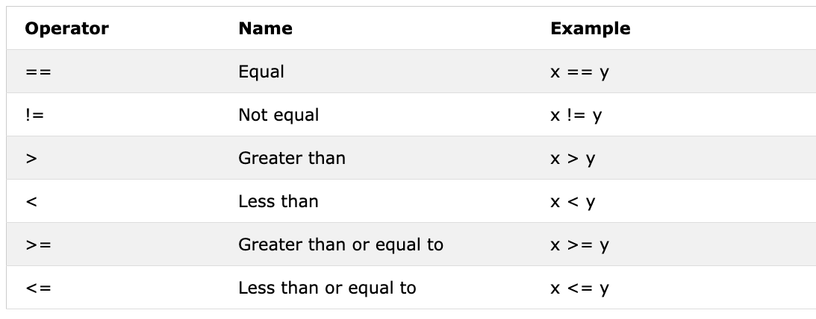
Comparison Operators
In programming we compare values, we use comparison operators to compare two values. We check if a value is greater or less or equal to other value.

Slide 15
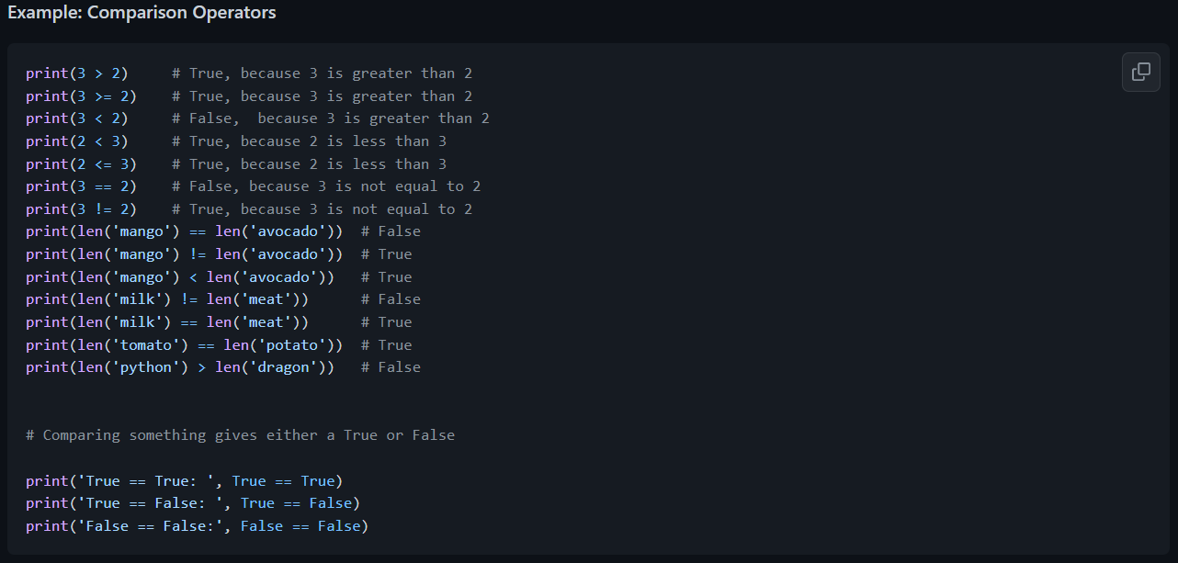

Slide 16
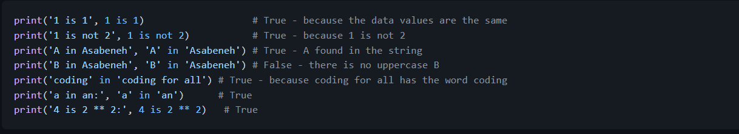
In addition to the above comparison operator Python uses:
is: Returns true if both variables are the same object(x is y)
is not: Returns true if both variables are not the same object(x is not y)
in: Returns True if the queried list contains a certain item(x in y)
not in: Returns True if the queried list doesn't have a certain item(x in y)

Slide 17
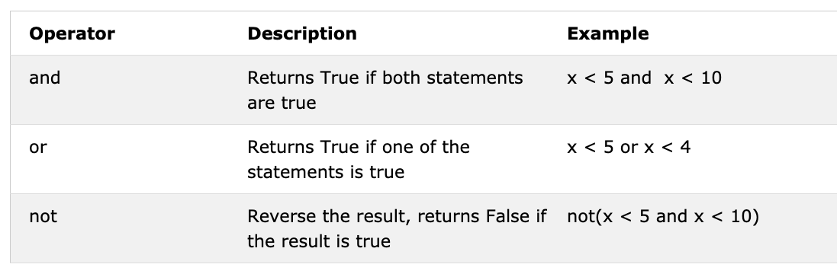
Logical Operators
Unlike other programming languages python uses keywords and, or and not for logical operators. Logical operators are used to combine conditional statements:

Slide 18
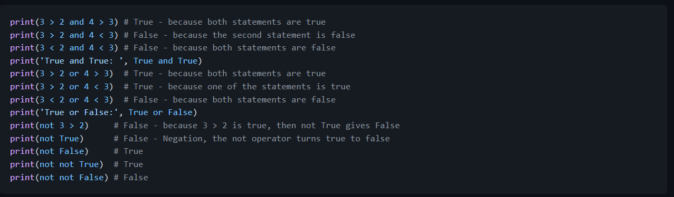
🌕 You have boundless energy. You have just completed day 3 challenges and you are three steps ahead on your way to greatness. Now do some exercises for your brain and your muscles.

Slide 19
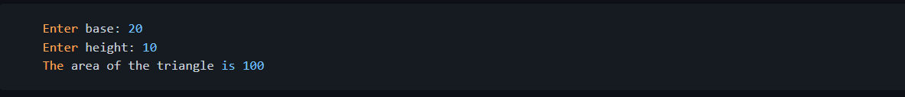
Exercises - Day 3
Declare your age as integer variable
Declare your height as a float variable
Declare a variable that store a complex number
Write a script that prompts the user to enter base and height of the triangle and calculate an area of this triangle (area = 0.5 x b x h).

Slide 20
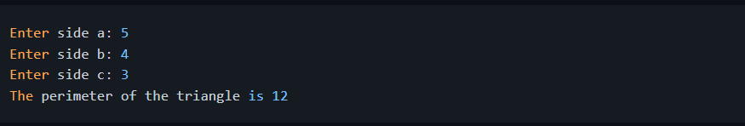
Write a script that prompts the user to enter side a, side b, and side c of the triangle. Calculate the perimeter of the triangle(perimeter = a + b + c).
Get length and width of a rectangle using prompt. Calculate its area (area = length x width) and perimeter (perimeter = 2 x (length + width))
Get radius of a circle using prompt. Calculate the area (area = pi x r x r) and circumference (c = 2 x pi x r) where pi = 3.14.

Slide 21
Calculate the slope, x-intercept and y-intercept of y = 2x -2
Slope is (m = y2-y1/x2-x1). Find the slope and Euclidean distance between point (2, 2) and point (6,10)
Compare the slopes in tasks 8 and 9.
Calculate the value of y (y = x^2 + 6x + 9). Try to use different x values and figure out at what x value y is going to be 0.
Find the length of 'python' and 'dragon' and make a falsy comparison statement.

Slide 22
Use and operator to check if 'on' is found in both 'python' and 'dragon'
I hope this course is not full of jargon. Use in operator to check if jargon is in the sentence.
There is no 'on' in both dragon and python
Find the length of the text python and convert the value to float and convert it to string
Even numbers are divisible by 2 and the remainder is zero. How do you check if a number is even or not using python?

Slide 23
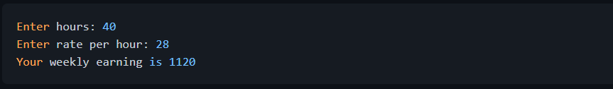
Check if the floor division of 7 by 3 is equal to the int converted value of 2.7.
Check if type of '10' is equal to type of 10
Check if int('9.8') is equal to 10
Write a script that prompts the user to enter hours and rate per hour. Calculate pay of the person?

Slide 24
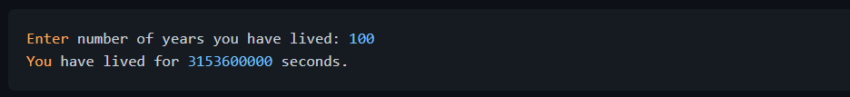
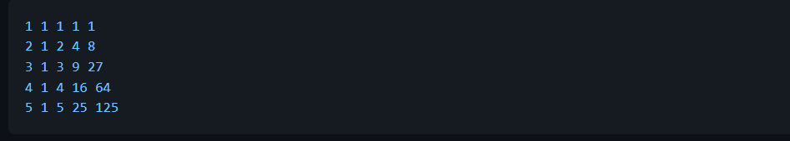
Write a script that prompts the user to enter number of years. Calculate the number of seconds a person can live. Assume a person can live hundred years
Write a Python script that displays the following table

